Slide 1



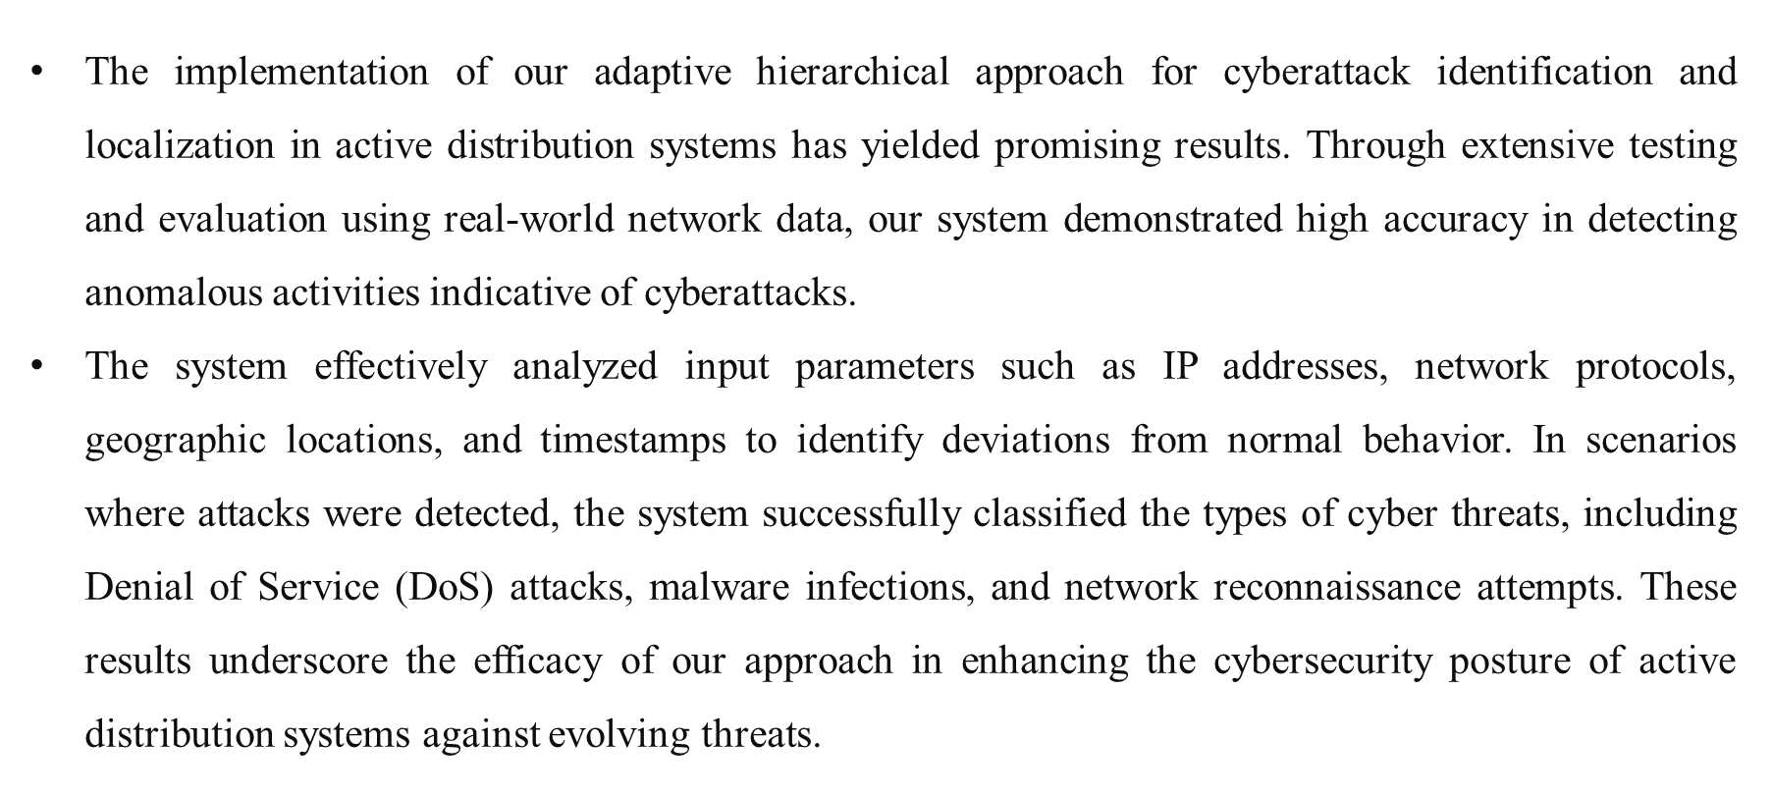
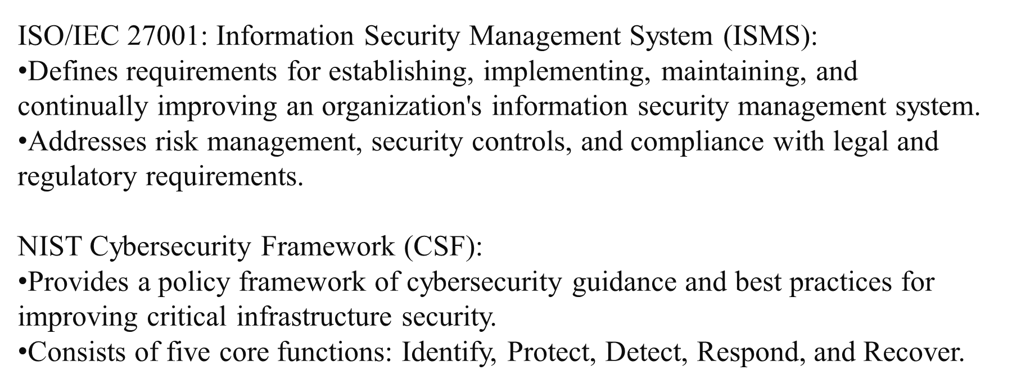
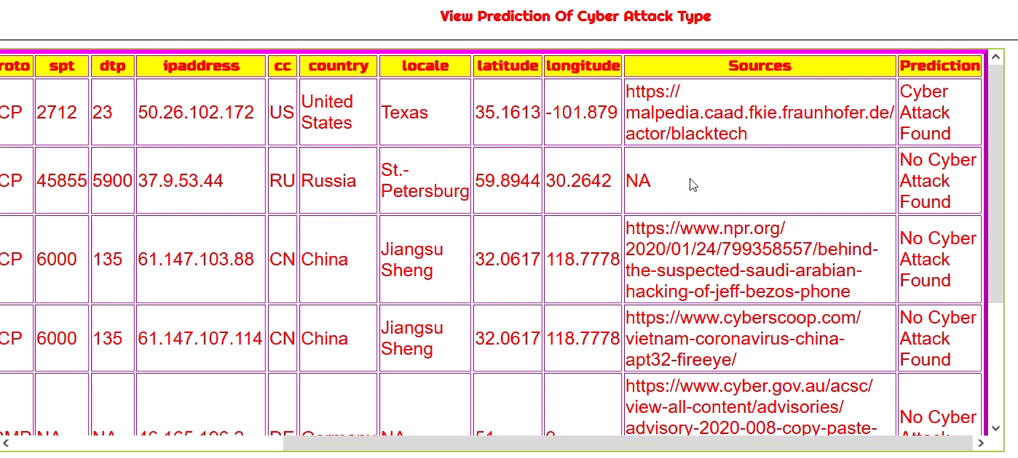
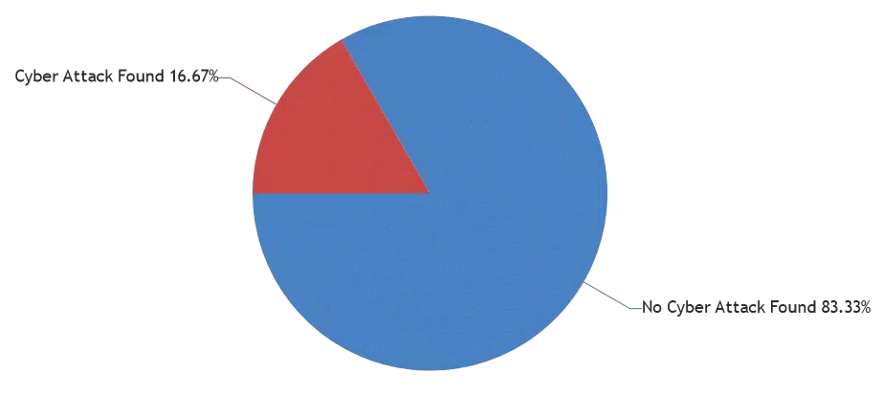
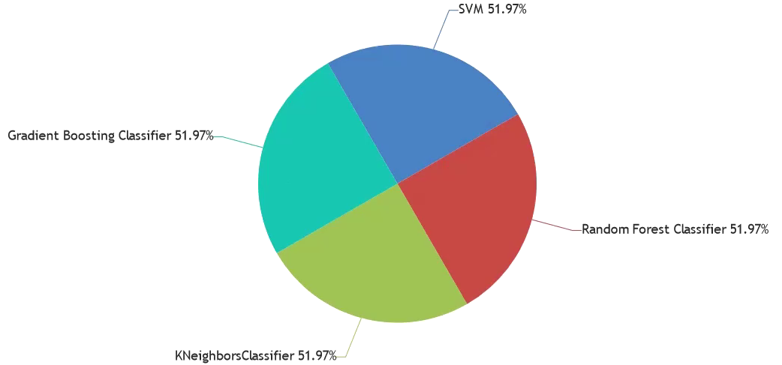
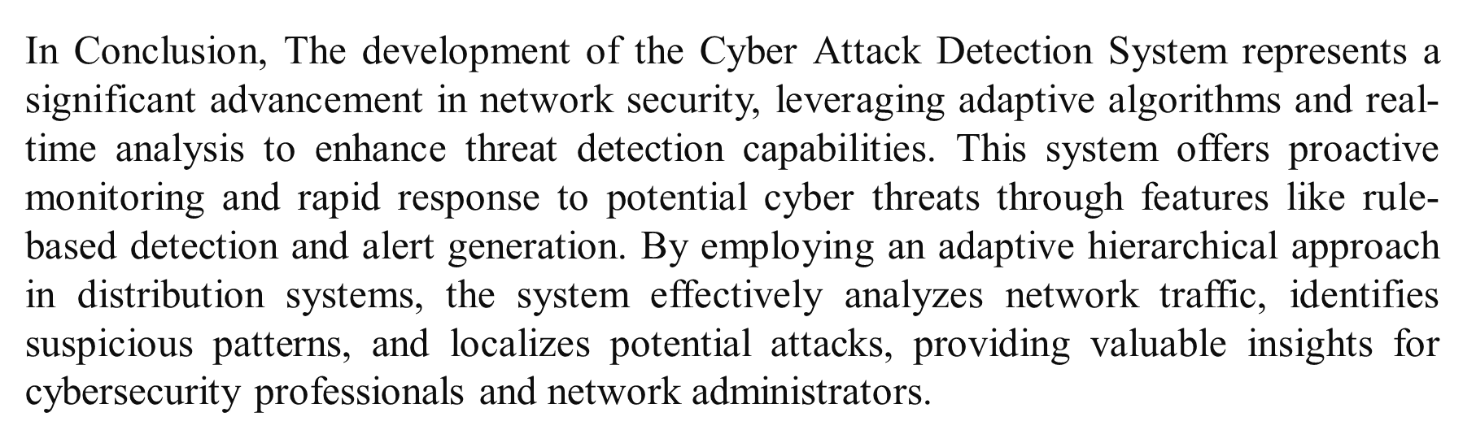
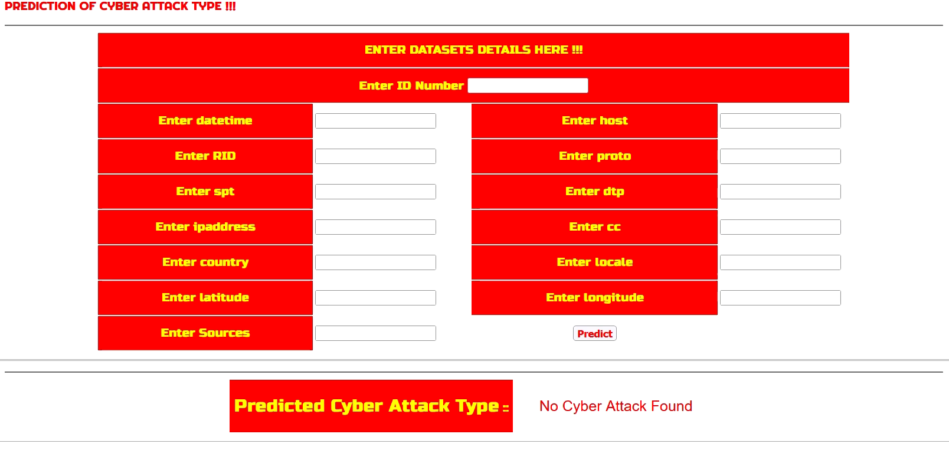
Cyberattack Identification and Localization Using Adaptive Hierarchical Approach in Active Distribution Systems
Department of Computer Science and Engineering Batch: (2020-2024)
School of Computing
1156CS701-MAJOR PROJECT
INHOUSE
WINTER SEMESTER 2023-2024
ABSTRACT
INTRODUCTION
RESULTS
STANDARDS AND POLICIES
Integration of advanced technologies into distribution systems increases vulnerability to cyber attacks.
Proposed adaptive hierarchical approach for cyber attack detection and localization aims to enhance resilience of active distribution systems.
Hierarchical structure allows efficient processing and analysis of diverse data sources like smart meters, sensors, and SCADA systems.
Machine learning algorithms enable continuous learning from historical data to improve detection capabilities and counter emerging threats.
System utilizes hierarchical layers to localize detected attacks, facilitating swift response and mitigation measures.
Effectiveness of approach validated through simulation studies on realistic distribution system models, demonstrating potential to bolster security against evolving cyber threats.
The rapid advancement of digital technologies has revolutionized power distribution systems, leading to the emergence of active distribution networks (ADNs) characterized by bidirectional power flows, distributed energy resources (DERs), and enhanced monitoring and control capabilities.
While these advancements promise greater efficiency, reliability, and sustainability, they also introduce new challenges, particularly in cybersecurity.
Cyber attacks targeting power distribution systems pose significant threats to grid stability, operational integrity, and the safety of critical infrastructure.
Traditional security measures, often focused on perimeter defense and intrusion detection, are inadequate to protect against sophisticated cyber threats that exploit vulnerabilities across interconnected devices and systems.
METHODOLOGIES
Data Collection and Preprocessing: Gather data from various sources within the active distribution system, including smart meters, sensors, SCADA systems, and communication networks. Preprocess the data to remove noise, handle missing values, and normalize the features.
Feature Extraction: Extract relevant features from the preprocessed data, such as power consumption patterns, voltage levels, frequency deviations, and network traffic characteristics. Utilize advanced techniques like wavelet transforms or Fourier analysis to extract temporal and spectral features.
Anomaly Detection: Implement machine learning algorithms, such as support vector machines (SVM), random forests, or deep learning models, to detect anomalies in the system behavior. Train the models using historical data and validate their performance on unseen data to ensure robustness.
Figure 3. Cyberattack result.
Figure 4. Algorithm Accuracy.
CONCLUSIONS
Figure 1. Prediction of attack types.
TEAM MEMBER DETAILS
vtu16850/MOHAMMAD AFROZ
vtu16937/D M PHANI BHUSHAN
Vtu12412/ G C SASI KANTH
+91 9346567488
+91 9182455659
+91 6305348287
vtu16850@veltech.edu.in
vtu16937@veltech.edu.in
vtu12412@veltech.edu.in
ACKNOWLEDGEMENT
Dr. S. RAVIKUMAR, M.Tech, Ph.D., / ASSOCIATE PROFESSOR
+91 9597999100
ravikumars@veltech.edu.in
Figure 2. Identified Cyberattack.

